Slide 1
Introduction to Git collaboration workflows
Branching & Merging
+
Distributed collaboration models
Author: Jürgen Altfeld
License: GPL3
Last updated: May, 2018

Slide 2

Copyright and license
Copyright (C) 2018 Jürgen Altfeld (R@altfeld-im.de)
This program is free software: you can redistribute it and/or modify
it under the terms of the GNU General Public License as published by
the Free Software Foundation, either version 3 of the License, or
(at your option) any later version.
This program is distributed in the hope that it will be useful,
but WITHOUT ANY WARRANTY; without even the implied warranty of
MERCHANTABILITY or FITNESS FOR A PARTICULAR PURPOSE. See the
GNU General Public License for more details.
You should have received a copy of the GNU General Public License
along with this program. If not, see http://www.gnu.org/licenses/

Slide 3
Some Git terms first... [TODO]
Repository
Remote
Origin
Pull & Push
Branch & Merge

Slide 4
Branching & Merging

Slide 5
Types of branches:
From short-lived to long-running branches
Branch name | Alternative names | Purpose
hotfix/v[x.xx] |  | unplanned releases ;-)
maint/v[x.xx] |  | updates for the last major release
release/v[x.xx] |  | to maintain a released software version
pre-release |  | to prepare a release (release candidate)
master | stable, trunk | production-ready state
integration | proposed, pu (= proposed updates) | integration testing branch
develop | unstable, next | new development ready for integration testing
feature/[name] | topic/[name], bugfix/[issue_no] | a feature under development
Progressive stability principle:
Merge only into a more stable branch if your code has the respective level of stability for the target branch!

Slide 6
Example commits for a simple project workflow
release/v1.0
master
develop
branch name
branch
feature/fb1
X
merge
"Forward
Integration"
commit
feature/fb2
X
commited version
X
deleted branch

Slide 7
Git commands

Slide 8
Git configuration commands
Git command | Description
git config --global --list | Show the current global settings
git config --global --edit | Open the settings file with in an editor (can be modified)
git config --system core.editor <editor> | Set the text editor used by Git commands for all users on the machine
git config --global user.name "YOUR FULL NAME" | Set the name used to label commits
git config --global user.email "EMAIL ADDRESS" | Set the email address used to label commits
git config --global merge.conflictstyle diff3 | Use diff3 for easier conflict resulutionin case of merge conflicts
git config --global push.followTags true | Include "good" tags (annotated and reachable at the remote) in a push
git config --global alias.<name> <git-command> | Create an Git alias (a kind of short command)
Note: Use --local instead of --global to change only the settings of current repo

Slide 9
Git commands for feature branches
1
# Create new feature branch
git checkout develop
git pull
git checkout -b feature/fbx
# Optional: Push new feature
# branch to remote repository
git push -u origin feature/fbx
3
4
# Forward integrate changes
git checkout develop
git pull
git checkout feature/fbx
git merge develop
# Release feature by merging
# back into a new merge commit
git checkout master
git pull
git merge --no-ff feature/fbx
develop
branch name
# To solve merge conflicts:
git status # show unmerged files
git diff # show conflicting files
# Mark files with solved conflicts
git add . # inside prj. root
git commit -m "commit msg"
# Detect forgotten merge markers
git diff --check
# If you get confused:
# Abort the merge and try again:
git merge --abort
git pull
branch
merge
feature/fbx
X
commit
2
5
# Commit all changes
git add .
git commit -m "commit msg"
# Optional: Delete feature branch
# after final merging
# to clean-up branches
git branch -d feature/fbx
commited version
X
deleted branch

Slide 10
Commands to understand and solve merge conflicts
# To solve merge conflicts:
git status # show unmerged files
git diff # show conflicting files
# Commit all files with solved conflicts:
git add . # inside prj. root
git commit -m "commit msg"
# Open a graphical merge tool
git mergetool
# Detect forgotten merge markers
git diff –check
# Examine conflicts:
# Show conflict related commits of both sides
git log --oneline --left-right –merge
# Show who changed which line and when in a file
git blame <file.name>
git gui blame <file.name> # shows changes in a GUI
# Show diff from two commits
git diff <commit-hash>..<commit-hash>
Understanding merge markers (diff3 format) in a file:
first line
<<<<<<< [Changes in your checkout branch ("HEAD"):]
second line in the master branch
||||||| [Original content before both changes:]
second line
======= [Changes in the other branch (merged into yours):]
second line in the branch
>>>>>>> branch_name [Marks the end of the conflict]
last line
# Abort merging if you get confused:
# Abort the complete merge and try it again:
git merge --abort
git pull
# Or: reset merge markers in a file to original state
git checkout –conflict diff3 <file.name>
# Special cases
# Merge ignoring whitespaces when comparing lines
git merge -Xignore-space-change <branch.name>

Slide 11
Git patch format
TODO
https://git-scm.com/docs/diff-format

Slide 12
Tagging of commits
# List all tags
git tag
# Mark head with a tag in your local repo
git tag -m "description" v1.0
# Mark specific commit with a tag
git log # show commit numbers to pick one
git tag -m "description" v1.0 <commit ID>
# Push a tag to the remote repo
# Tags are not pushed automatically
# when you push a branch!
git push origin v1.0
# Delete a remote tag:
git push --delete origin <tagname>

Slide 13
Git remote repo management
TODO
Show configure remotes: git remote -v
Add another remote to update a forked github repo from the original repo:
https://gist.github.com/CristinaSolana/1885435
# Add remote from original repository in your forked repository:
git remote add upstream <original repo URL> # you can find fetched branches from upstream in the local "upstream/<branch_name>" branch
git fetch upstream # Fetch the branches and their respective commits from the upstream repository.
git pull upstream master # Updating your fork from original repo (will merge automatically)
Better to use:
git fetch upstream # Fetch the branches and their respective commits from the upstream repository.
git pull --rebase upstream master [for clean repo history] after add and fetch remote.
Better ways:
https://help.github.com/articles/configuring-a-remote-for-a-fork
https://help.github.com/articles/syncing-a-fork/
https://help.github.com/articles/pushing-to-a-remote/

Slide 14
Git collaboration workflows
From centralized
to distributed collaboration workflows
Some picture taken from: https://git-scm.com/book/en/v2/Distributed-Git-Distributed-Workflows
License: https://github.com/progit/progit2/blob/master/LICENSE.asc
(Creative Commons Attribution-NonCommercial-ShareAlike 3.0 Unported License when the pictures were copied)
http://creativecommons.org/licenses/by-nc-sa/3.0/

Slide 15
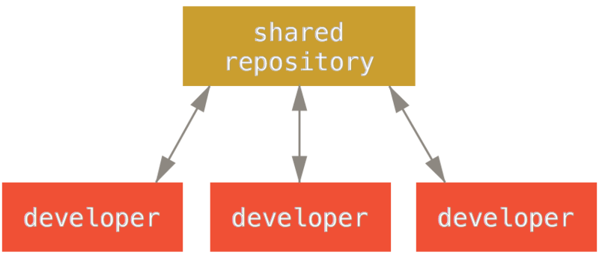
Centralized workflow

Slide 16
The peer-to-peer ("forking") workflow
developer
public
developer
public
developer
public
developer
private
developer
private
developer
private
The opposite of a centralized workflow is a peer-to-peer or forking workflow.
Instead of using a single shared repository each developer has a private (working) and a public repository

Slide 17
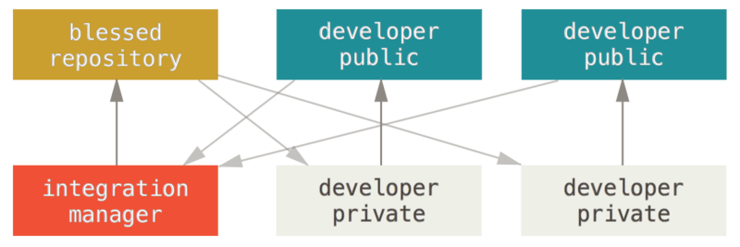
Integration-Manager Workflow
The project maintainer pushes to their public repository.
A contributor clones that repository and makes changes.
The contributor pushes to their own public copy.
The contributor sends the maintainer an email asking them to pull changes.
The maintainer adds the contributor’s repository as a remote and merges locally.
The maintainer pushes merged changes to the main repository.

Slide 18
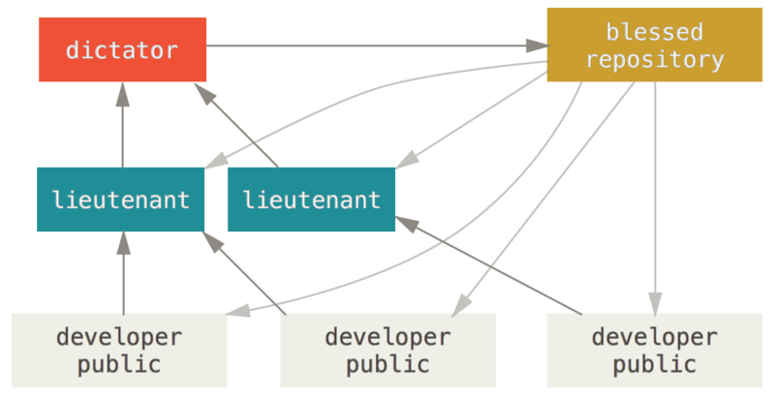
Dictator and Lieutenants Workflow
The project maintainer is called the "benevolent dictator" and accompanied by additional integration managers called "lieutenants" who in charge of certain parts of the repository (subsystems).
The blessed repository workflow is generally used by huge projects with hundreds of collaborators.

Slide 19
Appendix

Slide 20
Links
Content | URL
Git Feature Branch Workflow (Atlassian) | https://www.atlassian.com/git/tutorials/comparing-workflows/feature-branch-workflow
Detect forgotten merge markers | https://ardalis.com/detect-git-conflict-markers
Resolving merge conflicts in Git | http://genomewiki.ucsc.edu/index.php/Resolving_merge_conflicts_in_Git
Inspecting Changes with Diffs ("patches") | https://www.git-tower.com/learn/git/ebook/en/command-line/advanced-topics/diffs#start
Basic Merge Conflicts | https://git-scm.com/book/en/v2/Git-Branching-Basic-Branching-and-Merging#_basic_merge_conflicts
Git Tools - Advanced Merging | https://git-scm.com/book/en/v2/Git-Tools-Advanced-Merging
gitattributes - defining attributes per path | https://git-scm.com/docs/gitattributes
gitignore - Specifies intentionally untracked files to ignore | https://git-scm.com/docs/gitignore

